Slide 1
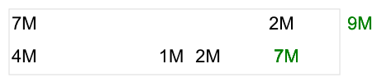
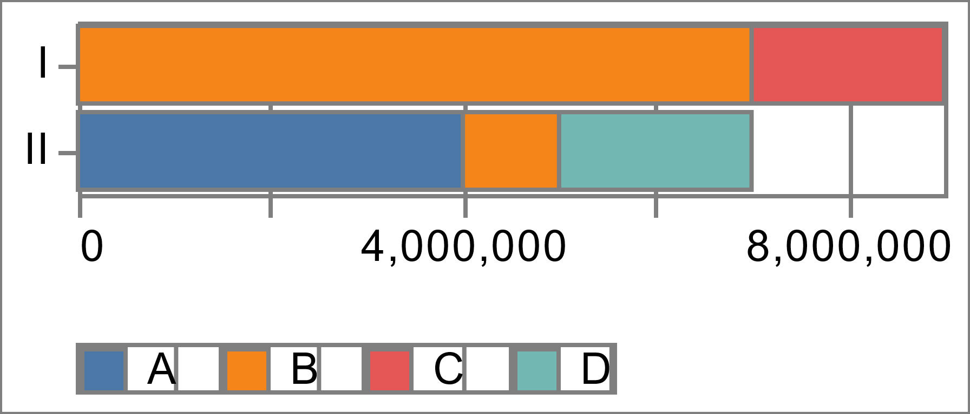
Multi-layered views
2023-05-20

Slide 2

Multi-layered views conceptual layout
“hconcat”:
Facet by row
Facet by row
Mark bar: horizontally stacked
Mark text: data labels for the segments
Mark text: data label for the total value
Mark rule:horizontally stacked
Mark point: filled
Mark bar: horizontally stacked
Mark text: data labels for the segments
Mark text: data label for the total value
Mark rule:horizontally stacked
Mark point: filled
2023-05-20

